Slide 1
Introduction to FOSS [1]
Dirk Riehle, FAU Erlangen
FOSS A01
Licensed under CC BY 4.0 International
[1] Free and Open-Source Software

Slide 2
Course Goals
Learning objectives
Learn how to use open-source software in projects and products correctly
  Understand the software bill of materials
  Understand open source governance
  Understand open source license compliance
  Understand vulnerabilities from open source
  Understand open source regulation

Slide 3
Skills Required for Course
Prerequisites
None
Required skills
Ability to read open source code
Ability to operate open-source software
Proficiency with tools and command line

Slide 4
Course Position in Curriculum
Bachelor’s |  |  |  |  |  | Master’s
1 | 2 | 3 | 4 | 5 | 6 | 1 | 2 | 3 | 4
 |  |  |  | ADAP | NYT |  | AMOS | AMOS | MATH
 |  |  |  | FOSS | FOSS |  | COACH | COACH
 |  |  |  | SEMI | SEMI | SEMI | SEMI | SEMI
 |  |  |  | PRAK | PRAK | PRAK | PRAK | PRAK
 |  |  |  |  | BATH
 |  |  |  |  | KOLL |  |  |  | KOLL

Slide 5
Courses and Modules
 |  | Courses (Lehrveranstaltungen)
 |  | Lecture (2 SWS) | Exercise (2 SWS) |  | Total ECTS
Modules | FOSS | x | x |  | 5

Slide 6
Availability of Modules
 |  | University
 |  | FAU Erlangen
Modules | FOSS | x
x = available
– = not available

Slide 7
FOSS vs. FLOSS vs. COSS vs. PROD
FOSS is not FLOSS nor COSS nor PROD
But FLOSS or COSS or PROD are still available modules
Please do not take FOSS if you want the old FLOSS or COSS or PROD
FOSS content is different from these other modules
If you take FOSS this semester, you agree to this new FOSS

Slide 8
Course Content
Open source compliance with
Licenses and
Regulation

Slide 9
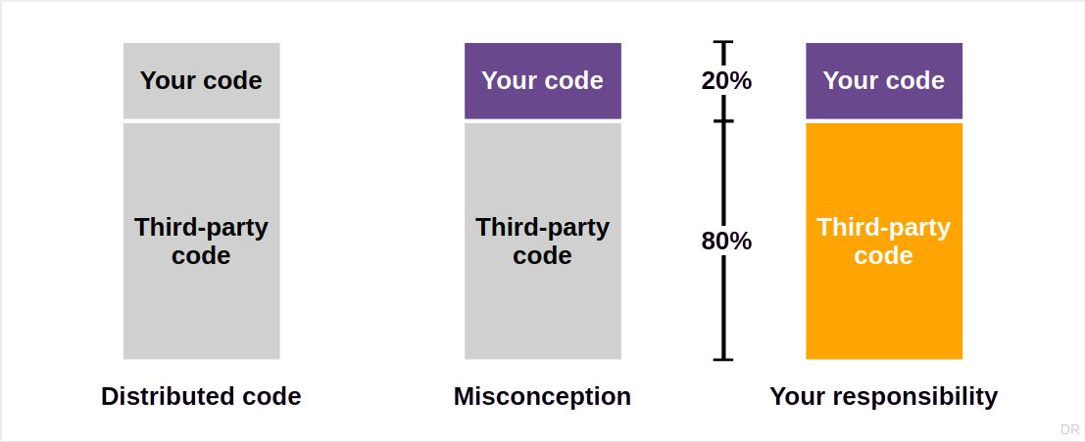
The Scope of Open Source Compliance

Slide 10
Course Overview
A. The software bill of materials
The software bill of materials
The dependency graph
Software composition analysis
C. License compliance
The open source legal notices
Efficient engineering workflows
Current compliance challenges
B. Open source governance
Open-source software licenses
Copyleft and intellectual property risks
The open source program office
D. Regulatory compliance
The software supply chain
Open source compliance regulation
Vulnerability management

Slide 11
Course Grading
Four exercises of different weighting
Miss more than one exercise and you fail the course

Slide 12
Course Management System
Please sign up on https://myc.uni1.de for the course [1]
Make sure your first and last name match your university credentials
[1] Please use your university email address; do not use GMX or web.de email addresses

Slide 13
Receiving a Grade for the Course
Course management and exam registration are two separate things
If you want to receive a grade
You must register through your university’s exam registration system
  Your degree program may have split the course into two (VL + UE)
  Please check asap that the course is available in your degree program!
Otherwise: No grade

Slide 14

No Oral or Written Exam [1]
[1] You still have to register for the course

Slide 15
Course Language
Class and homework
Lecturer: English
Student: English

Slide 16
Course Organization
Course organization a.k.a. information index
See https://foss.uni1.de
Course schedule
See Schedule tab on Course organization doc

Slide 17
Work Rhythm
Lecture (class discussion)
Exercise (homework review)
Homework (self-organized)

Slide 18
Course Communication
Announcements are sent by email
Through email aliases
Through course management system
Administrative questions to teaching team
Please ask your questions in the course forum
For private questions, use the teaching team email alias

Slide 19
Thank you! Any questions?
dirk.riehle@fau.de – https://oss.cs.fau.de
dirk@riehle.org – https://dirkriehle.com – @dirkriehle

Slide 20
Legal Notices
License
Licensed under the CC BY 4.0 International license
Copyright
© Copyright 2025 Dirk Riehle, some rights reserved

